Slide 1
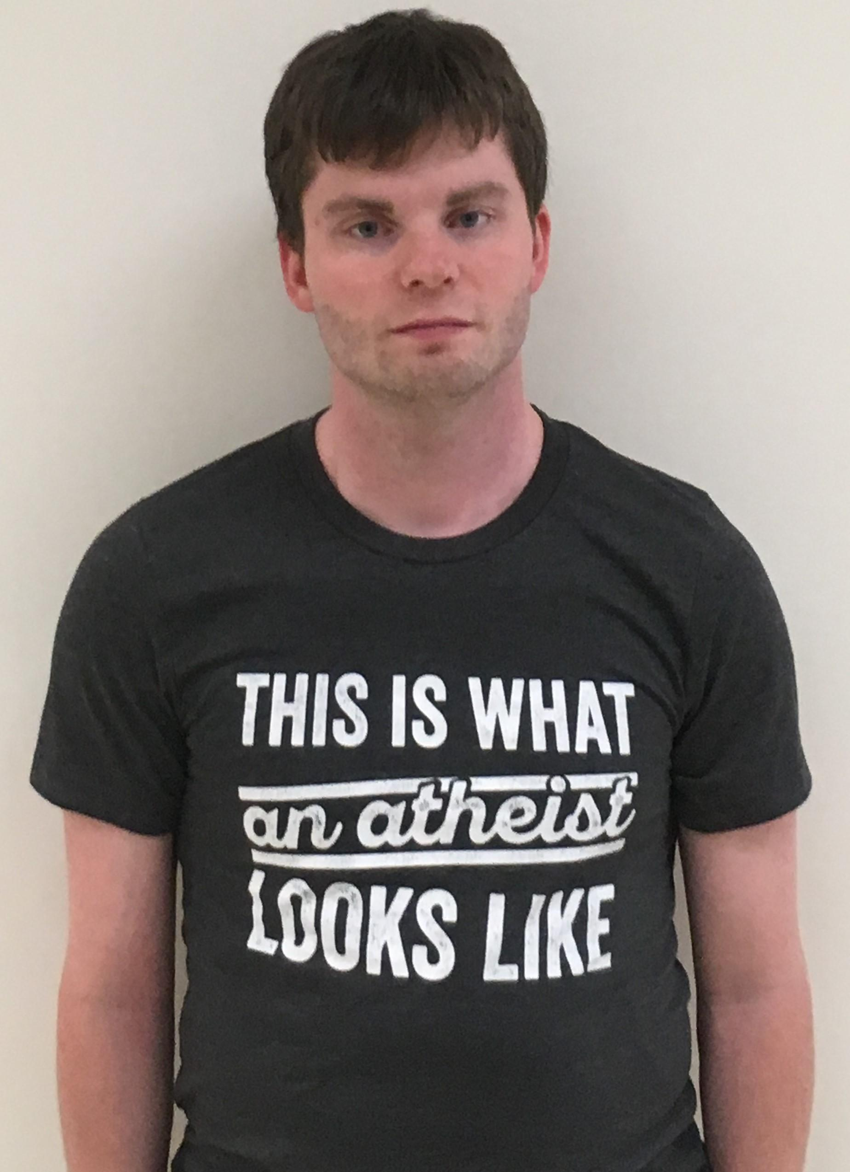

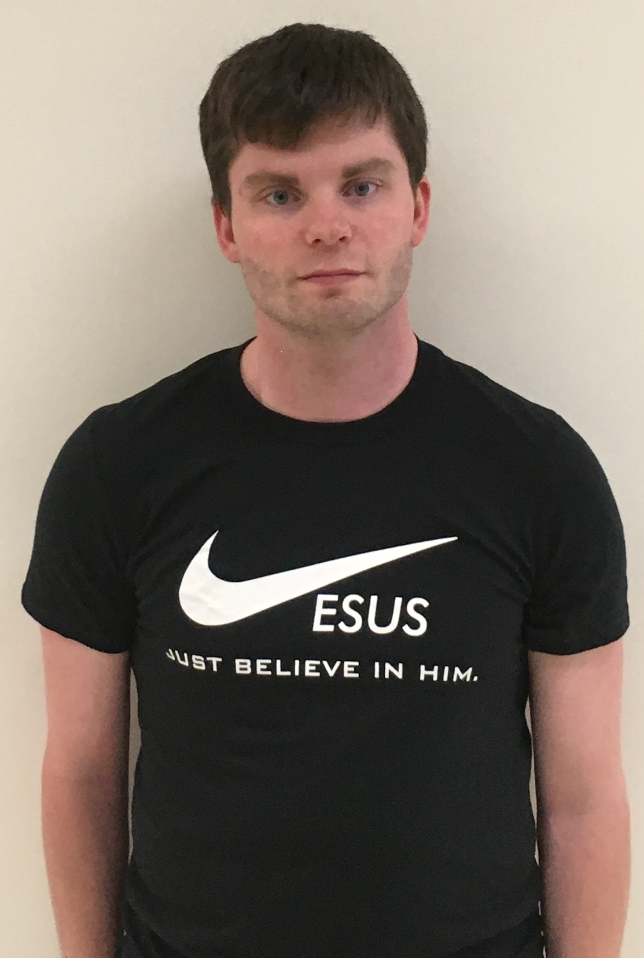
Group Affiliation and Social Distancing:
The Role of Religious Affiliation on Prosocial Behavior
Brier Gallihugh; Rusty McIntyre
¹Eastern Michigan University, Ypsilanti, MI
Introduction
Results
Discussion
The present study looked to explore the effect that religious affiliation can have on in-group and out-groups’ preferences and biases with respect to a wide range of hypothetical actions (positive and negative) and trait attributions among general psychology college students.
In this work we examined whether or not these particular groups would show a group bias toward a hypothetical target that was identified as Christian, Atheist or Neutral.
Christian Participants
Findings indicated that Christian’s were more likely to say hello to fellow Christian t-shirt wears than they were an atheist t-shirt.
In addition, Christians were also more likely to refuse help to a neutral t-shirt wearer than Non-Christians were.
Christians show no statistical difference across conditions in either their willingness to ostracize or talk badly about atheist or neutral t-shirt wearers.
Other Participants
Non-Christian’s showed no statistical difference among conditions on their willingness to say hello.
Non-Christians showed no statistical difference across conditions with respect to their willingness refuse help.
However, Non-Christians were more likely to ostracize Christian t-shirt wears compared to atheist and neutral t-shirt wearers.
Non-Christians were also more likely to talk badly about Christian t-shirt wears than they were neutral t-shirt wearers.
Taken together these findings suggest that religious affiliation does play at least a marginal role in some the behaviors individuals are willing to perform and take part in with others
However, it should be noted that religious affiliation did not seem to play a role in a majority of the actions that some individuals are willing to perform and take part in with others.
Lastly, religious affiliation did not appear to impact how individual’s rated the hypothetical character with respect to positive and negative trait attributions
Background
Additionally, in-group and out-group dynamics show up consistently (Mullen, Brown & Smith, 1992)
Research has shown that in group and out group effects can be present even when looking at something as seemingly trivial as sports rivalry (Wann & Grieve, 2005)
Prior work on in-group bias typically finds that individuals prefer their own groups but show a negative bias toward members of out-groups (Levine, Prosser, Evans & Reicher, 2005).
Future Directions
Future research should look to better operationalize religious identification. Our method involved self report which made it difficult to objectively categorize more participants than would be desired
Future research also might look to see how hypothetical behaviors used in the online study translate to real world behavior in a laboratory or real world setting
Finally, future research might be wise to look at finding a larger population of minority faith participants
Methods
Participants
Participants were college students enrolled in general psychology courses at Eastern Michigan University.
Participants self identified as either Christian (N = 111) or Other (N = 102)
The “Other” group consisted of Jewish, Muslim, Atheist, Agnostic, Hindu, or Other religiously
Procedure
Participants were randomly assigned to see one of three different pictures of a hypothetical person named “Jeremy” in an online study.
Jeremy was pictured in one of three themed t-shirts: Atheist, Christian or Neutral
Asked to read a brief description of Jeremy’s day through the eyes of a friend (this was an adapted version of the Srull & Wyer, 1979, Donald paragraph).
Participants were then asked to rate Jeremy as to the degree participant’s felt Jeremy possessed either positive or negative traits as well as their willingness to engage in a variety of behaviors with Jeremy. Generally, measures were scaled using a 5 or 11pt Likert scales as well as feeling thermometers.
Acknowledgements
I would like to thank Dr McIntyre for his continued support and guidance during this project as well as participants for their time and effort in completing the various instruments. Their support, guidance and time are greatly appreciated
References
Levine, M., Prosser, A., Evans, D., & Reicher, S. (2005). Identity and emergency intervention: How social group membership and inclusiveness of group boundaries shape helping behavior. Personality and Social Psychology Bulletin, 31(4), 443-453.
Mullen, B., Brown, R., & Smith, C. (1992). Ingroup bias as a function of salience, relevance, and status: An integration. European Journal of Social Psychology, 22(2), 103-122.
Srull, T. K., & Wyer, R. S. (1979). The role of category accessibility in the interpretation of information about persons: Some determinants and implications. Journal of Personality and Social Psychology, 37(10), 1660-1672.
Wann, D. L., & Grieve, F. G. (2005). Biased evaluations of in-group and out-group spectator behavior at sporting events: The importance of team identification and threats to social identity. The Journal of Social Psychology, 145(5), 531-545.
Atheist T-Shirt Condition
Neutral T-Shirt Condition
Christian T-Shirt Condition

